Slide 1
Unit-3

Slide 2
Evaluating Hypotheses: Estimating hypotheses Accuracy
For estimating hypothesis accuracy, statistical methods are applied.
Evaluating hypotheses:
Whenever you form a hypothesis for a given training data set, for example, you came up with a hypothesis for the EnjoySport example where the attributes of the instances decide if a person will be able to enjoy their favorite sport or not.
Now to test or evaluate how accurate the considered hypothesis is we use different statistical measures. Evaluating hypotheses is an important step in training the model.

Slide 3
To evaluate the hypotheses precisely focus on these points:
First, how well does this estimate the accuracy of a hypothesis across additional examples, given the observed accuracy of a hypothesis over a limited sample of data?
Second, how likely is it that if one theory outperforms another across a set of data, it is more accurate in general?
Third, what is the best strategy to use limited data to both learn and measure the accuracy of a hypothesis?

Slide 4
Motivation: There are instances where the accuracy of the entire model plays a huge role in the model is adopted or not. For example, consider using a training model for Medical treatment. We need to have a high accuracy so as to depend on the information the model provides.
When we need to learn a hypothesis and estimate its future accuracy based on a small collection of data, we face two major challenges:
1. Bias in the estimation: Initially, the observed accuracy of the learned hypothesis over training instances is a poor predictor of its accuracy over future cases.
Because the learned hypothesis was generated from previous instances, future examples will likely yield a skewed estimate of hypothesis correctness.

Slide 5
2. Estimation variability: Depending on the nature of the particular set of test examples, even if the hypothesis accuracy is tested over an unbiased set of test instances independent of the training examples, the measurement accuracy can still differ from the true accuracy.
The anticipated variance increases as the number of test examples decreases.
So, we need to address:
What is the best estimate of the accuracy of h over future instances taken from the same distribution, given a hypothesis h and a data sample containing n examples picked at random according to the distribution D?
What is the margin of error in this estimate of accuracy?

Slide 6
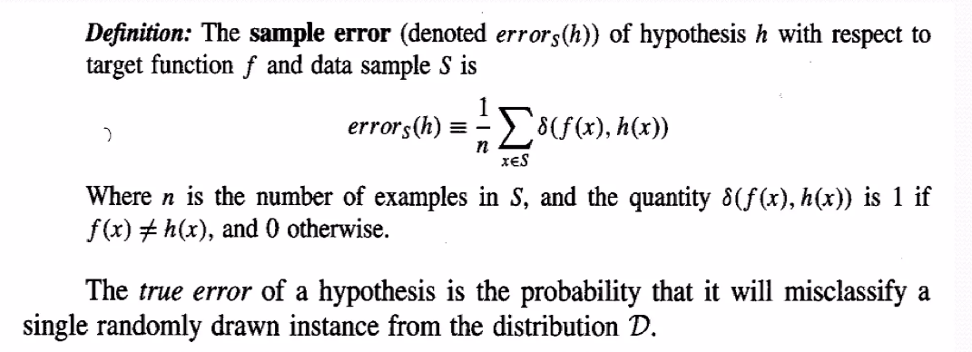
True Error and Sample Error

Slide 7
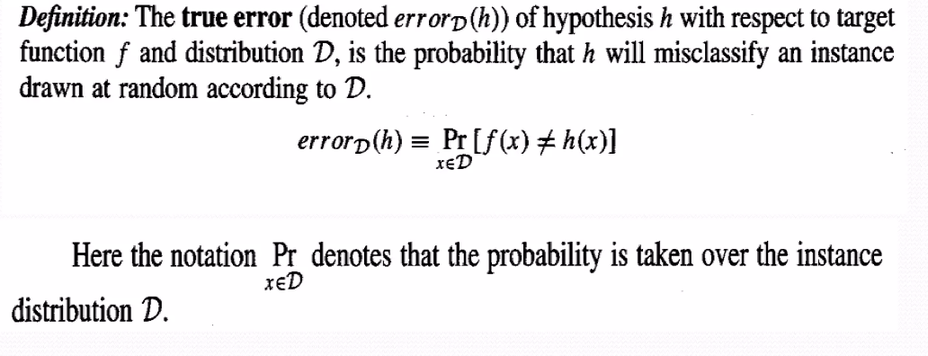

Slide 8
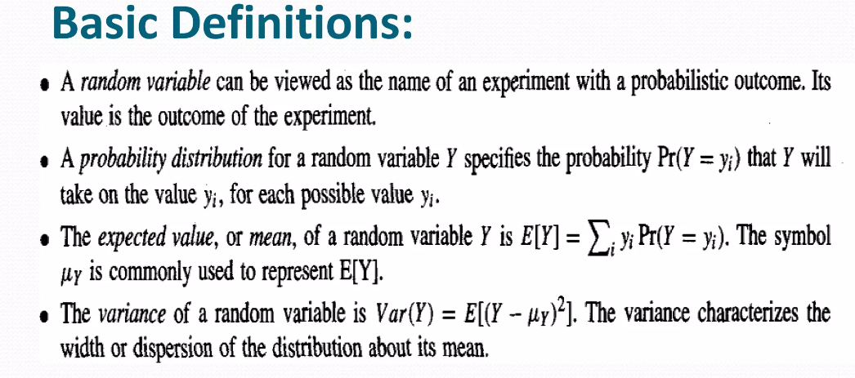
Basics of Sampling Theory

Slide 9
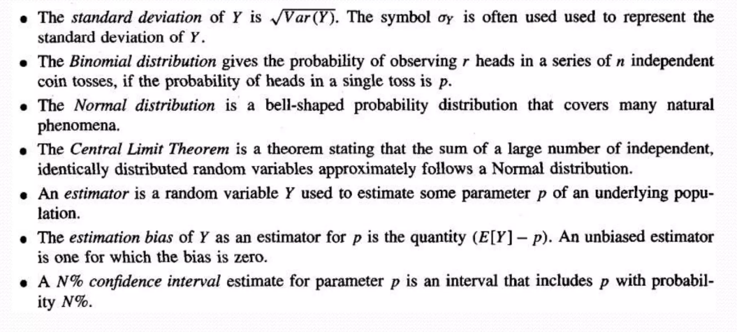

Slide 10
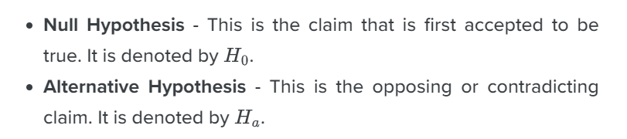
Types I & Type II Errors in Hypothesis Testing
Hypothesis testing is used to find out if a claim is true or not but during this process of testing, some errors can occur.

Slide 11
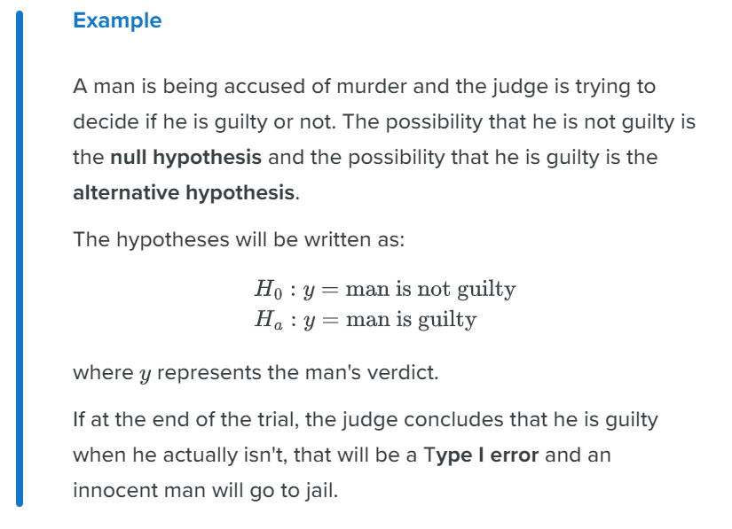
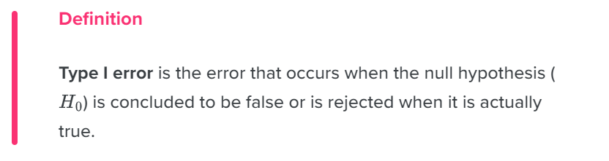
There are two types of errors in hypothesis testing, Type I and Type II errors.

Slide 12
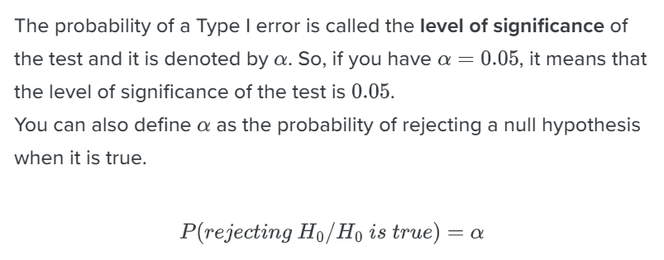

Slide 13
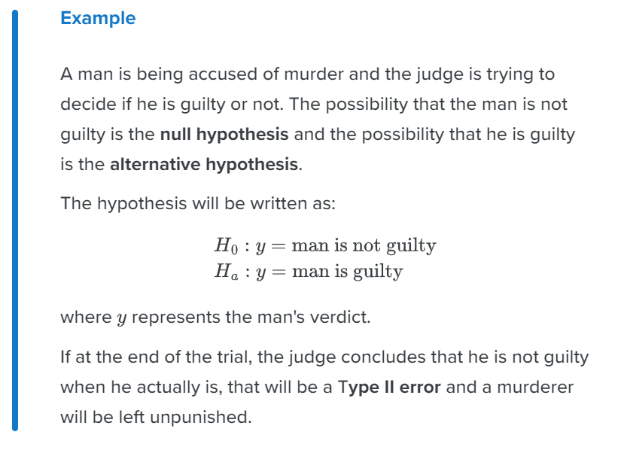
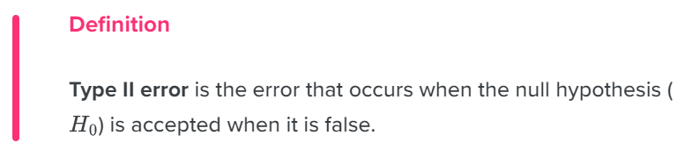
Type II Error in Hypothesis Testing

Slide 14
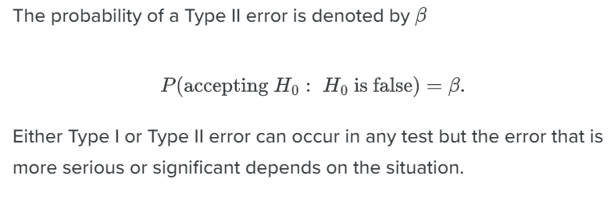
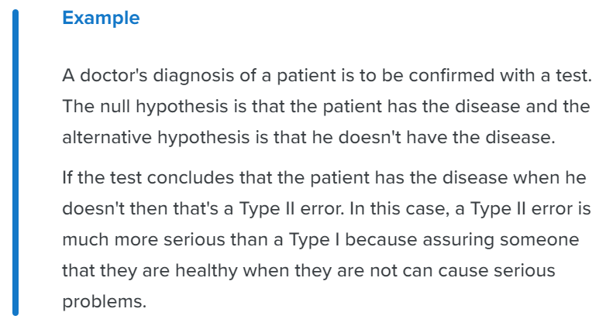

Slide 15
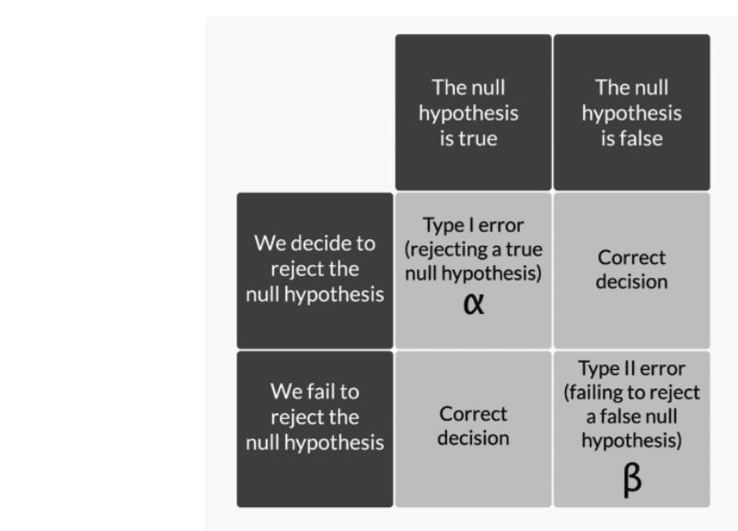

Slide 16
How to Compare Machine Learning Algorithms
ML algorithms can be compared on common grounds and they can be analyzed easily based on following parameters:
1. Time complexity: time complexity can be very different during training and testing.
2. Space complexity: Space complexity measures how much memory an algorithm needed to run in terms of the input size. A ML program could not be successfully run if a ML algorithm loads too much data into the working memory of a machine.

Slide 17
3. Sample complexity: Sample complexity measures the number of training examples needed to train the network in order to guarantee a valid generalization. For example, deep neural network has high sample complexity since lots of training data are needed to train it.
4. Bias-variance tradeoff: Different ML algorithms would have different bias-variance tradeoff. The bias errors come from the fact that a model is biased towards a specific solution or assumption.
5. Online and Offline: Online and offline learning refers to the way a machine learning software learns to update the model. Online learning means training data can be presented one at a time so that parameters can be updated immediately when new data are available.
Offline learning, however, requires the training to start over again (re-train the whole model) when new data presented in order to update the parameters. If an algorithm is an online one, it would be efficient since the parameters used in production can be updated in real-time to reflect the effect of new data. ID3 Decision tree algorithm is an example of offline learning

Slide 18
6. Parallelizability: A parallel algorithm means that an algorithm can complete multiple operations at a given time.
This can be done by distributing the workloads across different workers, like processors in a single machine or multiple machines.
The nature of k-nearest neighbors (k-NN) model allows it to be easily run on multiple machine at the same time.
7. Parametricity: The concept of parametricity is widely used in the fields of statistical learning. A parametric model means the number of parameters of a model is fixed while the number of parameters of a non-parametric model grows when more data are available.
Parametric model is very common in machine learning. Examples are linear regression, neural networks and many other ML models. k-NN and SVM (support vector machine).

Slide 19
Bayes Theorem
Bayes’ Theorem is named after Reverend Thomas Bayes.
It is used to find the probability of an event, based on prior knowledge of conditions that might be related to that event. It is a further case of conditional probability.

Slide 20
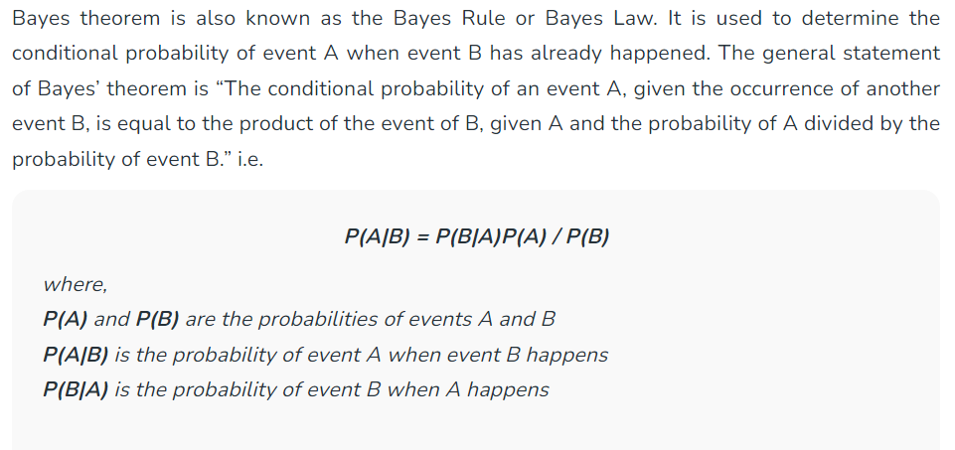

Slide 21
Bayes Theorem and Concept Learning
In Machine Learning, there are situations where you need to make decisions or predictions based on incomplete or noisy information.
Bayes Theorem allows calculating the probability of a hypothesis or event given the observed data. You can make more accurate predictions or decisions by incorporating prior knowledge and updating it with new evidence.
The theorem is based on the concept of conditional probability. This is the probability of an event occurring, given that another event has already happened.

Slide 22
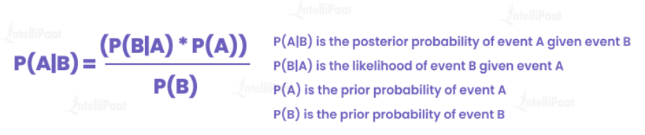
In Machine Learning, the Bayes Theorem is often applied in the context of Bayesian inference. This allows you to make predictions or estimate unknown quantities based on observed data.

Slide 23
Imagine you have a dataset of emails, where each email is labeled as either “spam” or “not spam.”
The objective is to construct a Machine Learning model that can autonomously classify incoming emails as either spam or non-spam, relying on the content of the messages as the basis for classification.
To apply Bayes Theorem in this scenario, make certain assumptions.
Assume that the words occurring in the emails are independent of each other. This means that the presence or absence of one word does not affect the presence or absence of another word.
This simplifies the problem and allows to apply the theorem effectively.

Slide 24
Let’s define some terms for better understanding:
P(Spam) represents the prior probability of an email being spam.
P(Not Spam) represents the prior probability that an email is not spam.
P(Word|Spam) is the probability of a word occurring in a spam email.
P(Word|Not Spam) is the probability of a word appearing in a non-spam email.
To classify a new email as spam or not, you can use the Bayes Theorem as follows:
Here, P(Spam|Word) is the posterior probability of an email being spam, given the occurrence of a particular word.

Slide 25
Naïve Bayes Classifier Algorithm
Naïve Bayes algorithm is a supervised learning algorithm, which is based on Bayes theorem and used for solving classification problems.
It is mainly used in text classification that includes a high-dimensional training dataset.
Naïve Bayes Classifier is one of the simple and most effective Classification algorithms which helps in building the fast machine learning models that can make quick predictions.
It is a probabilistic classifier, which means it predicts on the basis of the probability of an object.
Some popular examples of Naïve Bayes Algorithm are spam filtration, Sentimental analysis, and classifying articles.

Slide 26
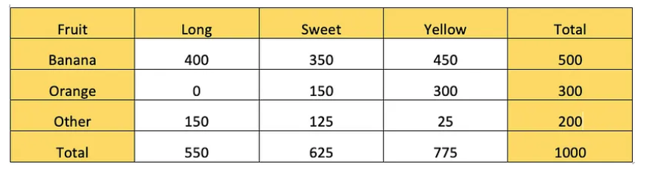
Example: There is some research about fruit characteristics from the 1000 total sample of different fruits
If we have a fruit that has a Long, Sweet, and Yellow characteristic. What fruit is it?

Slide 27
To know what fruit is it, we must compute the value of this probability.
Whether that fruit is a Banana P(Banana|Long, Sweet, Yellow)
Whether that fruit is an Orange P(Orange|Long, Sweet, Yellow)
Whether that fruit is the Other fruit P(Other|Long, Sweet, Yellow)

Slide 28
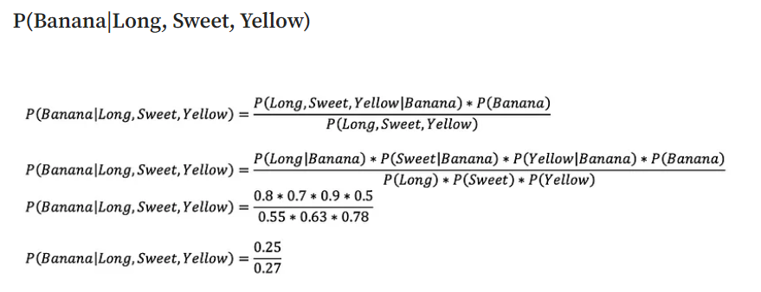

Slide 29
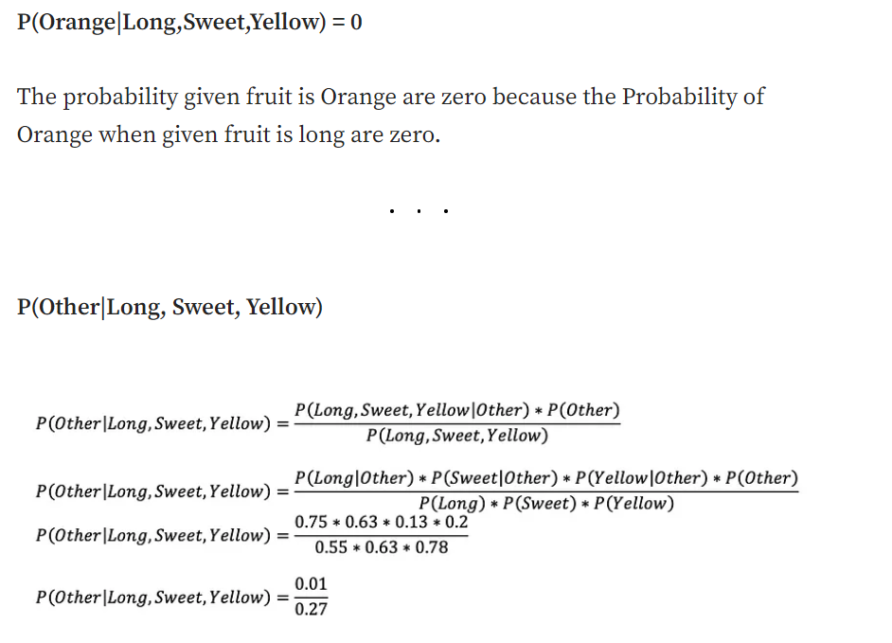
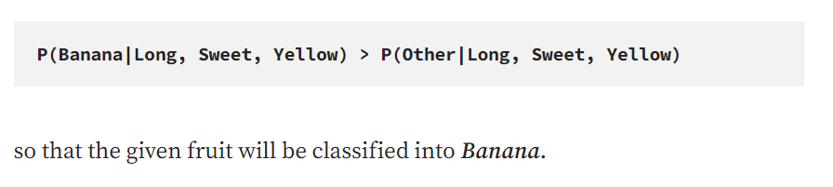

Slide 30
Advantages
Incorporating Prior Knowledge- Bayes Theorem allows to incorporate prior knowledge or beliefs into the model. This is particularly useful when you have domain expertise or existing information about the problem you are trying to solve. By incorporating prior knowledge, you can make more informed predictions and improve the accuracy of your models.
Handling Uncertainty– Machine learning often deals with uncertainty, especially when working with limited data or noisy inputs. Bayes Theorem provides a principled way to reason under uncertainty by updating beliefs based on observed evidence. It allows you to quantify and propagate uncertainty throughout the model, resulting in more robust and reliable predictions.
Flexibility in Model Updating- Based on Bayes Theorem, Bayesian inference lets you update your models as new data becomes available continuously. This is particularly useful in scenarios where the underlying data distribution may change over time. You can adapt your models and maintain their relevance and accuracy by updating the prior probabilities with new evidence.

Slide 31
Handling Small Data Sets- Bayesian methods can be advantageous when data is insufficient. By incorporating prior beliefs, you can leverage existing knowledge to overcome the limitations of small datasets. The prior probabilities act as a regularization term, helping to avoid overfitting and providing more stable predictions.
Transparent Decision Making- Bayes Theorem provides a transparent framework for decision-making. It allows you to express and update your beliefs based on observed evidence. This transparency is valuable for understanding model behavior, diagnosing issues, and explaining the reasoning behind predictions to stakeholders or end-users.
Flexibility in Model Selection- Bayesian inference facilitates model comparison and selection. By evaluating the posterior probabilities of different models, you can quantify their relative performance and choose the most suitable one. This flexibility allows you to compare complex models and select the one that best fits the data and problem.

Slide 32
Bayesian Belief Network
Bayesian Belief Network is a graphical representation of different probabilistic relationships among random variables in a particular set.
It is a classifier with no dependency on attributes i.e it is condition independent.
Due to its feature of joint probability, the probability in Bayesian Belief Network is derived, based on a condition — P(attribute/parent) i.e probability of an attribute, true over parent attribute.

Slide 33
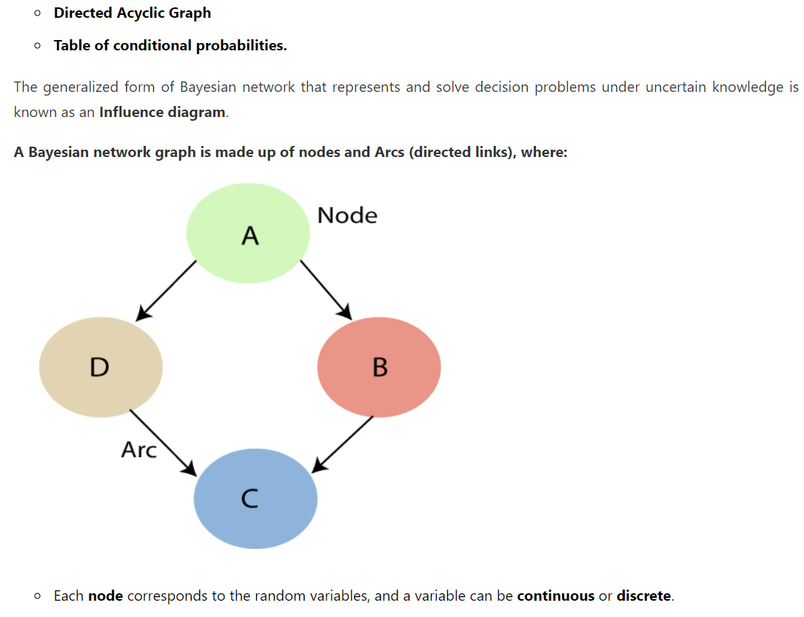
Bayesian Network can be used for building models from data and experts opinions, and it consists of two parts:

Slide 34
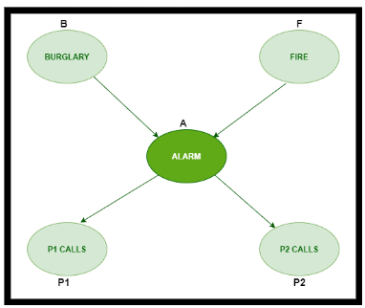
Example: In the given figure, an alarm ‘A’ – a node, say installed in a house of a person ‘gfg’, which rings upon two probabilities i.e burglary ‘B’ and fire ‘F’, which are – parent nodes of the alarm node. The alarm is the parent node of two probabilities P1 calls ‘P1’ & P2 calls ‘P2’ person nodes.
Upon the instance of burglary and fire, ‘P1’ and ‘P2’ call person ‘gfg’, respectively. But, sometimes ‘P1’ may forget to call even after hearing the alarm, Similarly, ‘P2’, sometimes fails to call the person.

Slide 35
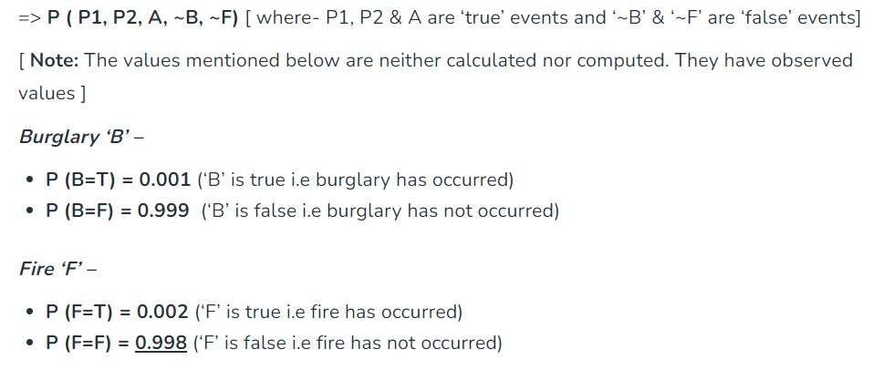
Q) Find the probability that ‘P1’ is true (P1 has called ‘gfg’), ‘P2’ is true (P2 has called ‘gfg’) when the alarm ‘A’ rang, but no burglary ‘B’ and fire ‘F’ has occurred.
Given:

Slide 36
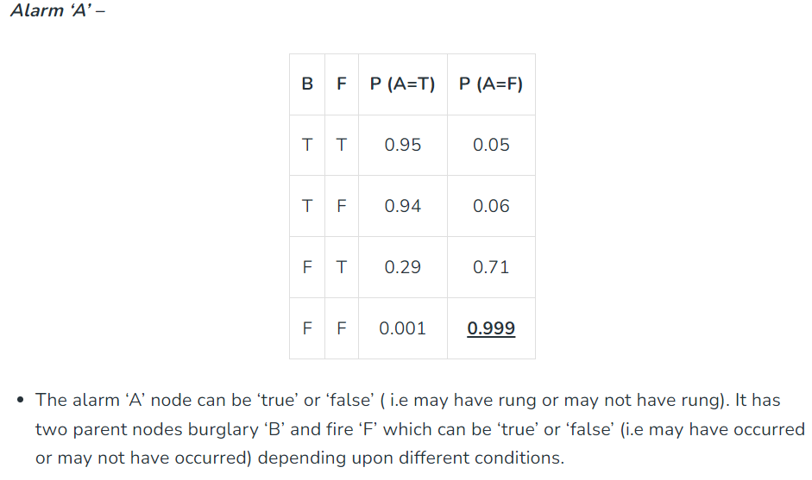

Slide 37
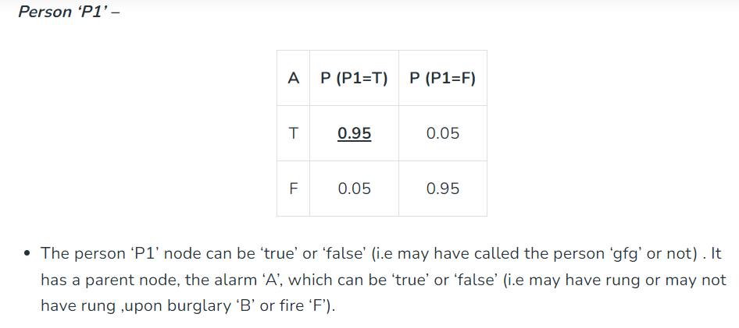

Slide 38
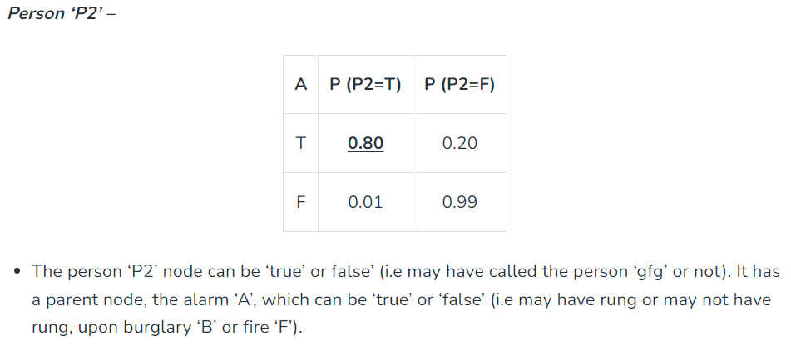

Slide 39
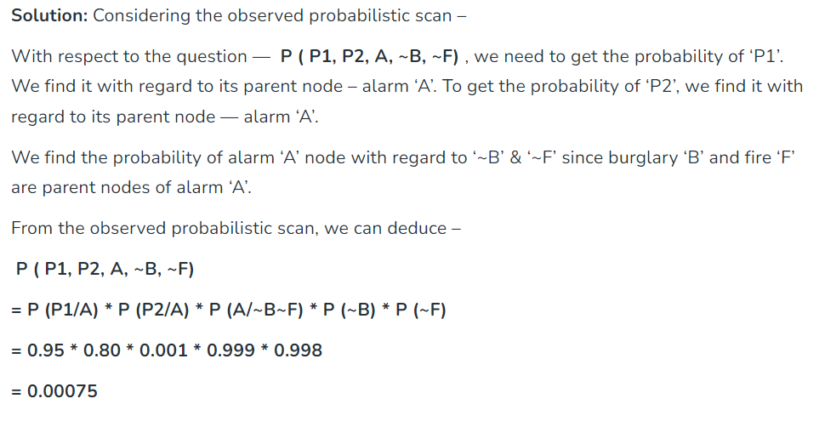

Slide 40
Expectation-Maximization Algorithm (EM algorithm)
In real-world machine learning applications, it is common to have many relevant features, but only a subset of them may be observable.
When dealing with variables that are sometimes observable and sometimes not, it is indeed possible to utilize the instances when that variable is visible or observed in order to learn and make predictions for the instances where it is not observable.
This approach is often referred to as handling missing data. By using the available instances where the variable is observable, machine learning algorithms can learn patterns and relationships from the observed data.

Slide 41
These learned patterns can then be used to predict the values of the variable in instances where it is missing or not observable.
The expectation-Maximization algorithm can be used to handle situations where variables are partially observable. When certain variables are observable, we can use those instances to learn and estimate their values. Then, we can predict the values of these variables in instances when it is not observable.
EM algorithm is applicable to latent variables, which are variables that are not directly observable but are inferred from the values of other observed variables.
The EM algorithm serves as the foundation for many unsupervised clustering algorithms in the field of machine learning. It provides a framework to find the local maximum likelihood parameters of a statistical model and infer latent variables in cases where data is missing or incomplete.

Slide 42
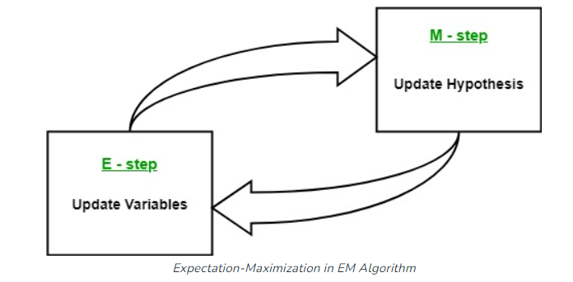
It consists of an estimation step (E-step) and a maximization step (M-step), forming an iterative process to improve model fit.
In the E step, the algorithm computes the latent variables i.e. expectation of the log-likelihood using the current parameter estimates.
In the M step, the algorithm determines the parameters that maximize the expected log-likelihood obtained in the E step, and corresponding model parameters are updated based on the estimated latent variables.
By iteratively repeating these steps, the EM algorithm seeks to maximize the likelihood of the observed data.
It is commonly used for unsupervised learning tasks, such as clustering, where latent variables are inferred and has applications in various fields, including machine learning, computer vision, and natural language processing.

Slide 43
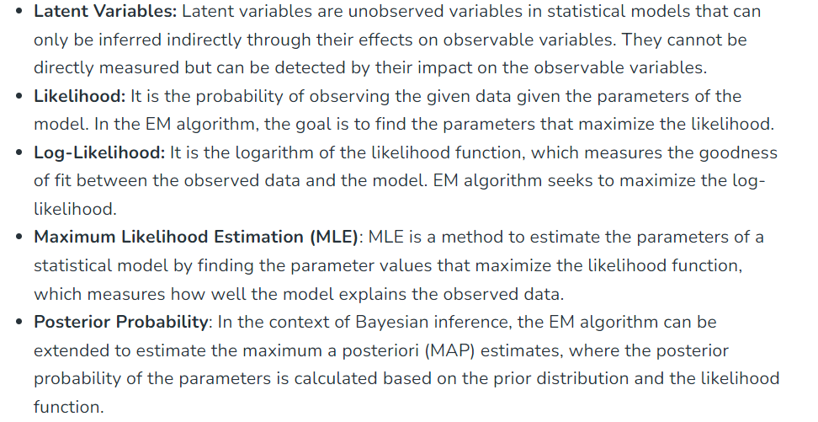
Key Terms in Expectation-Maximization (EM) Algorithm

Slide 44
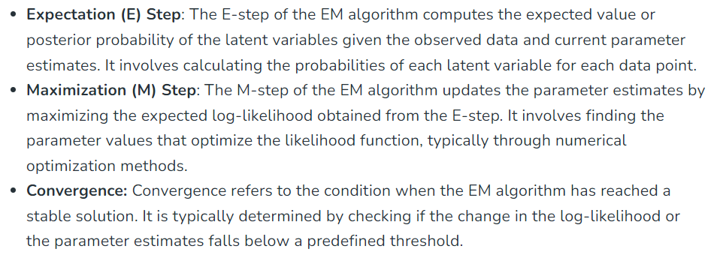

Slide 45
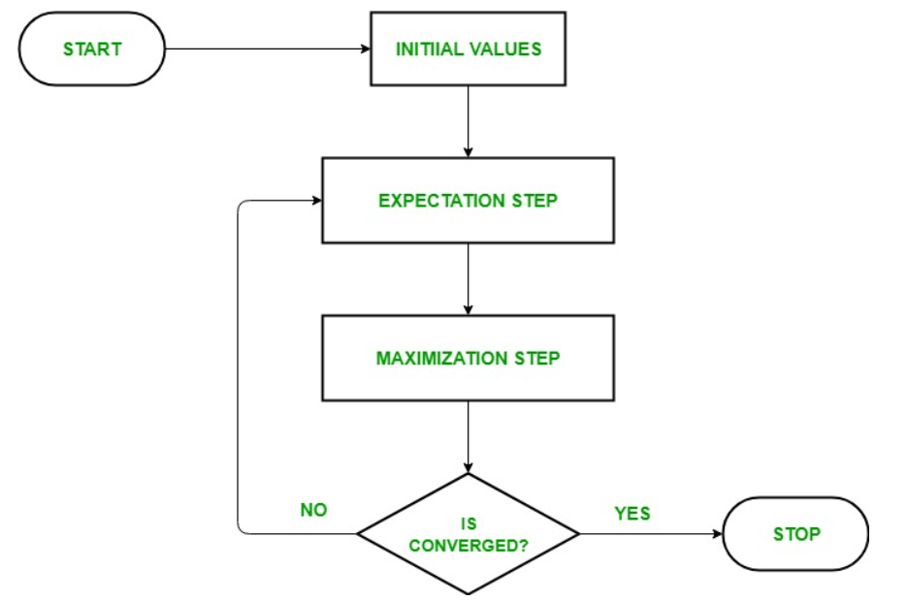
How Expectation-Maximization (EM) Algorithm Works:
The goal of the Expectation-Maximization algorithm is to use the available observed data of the dataset to estimate the missing data and then use that data to update the values of the parameters.

Slide 46
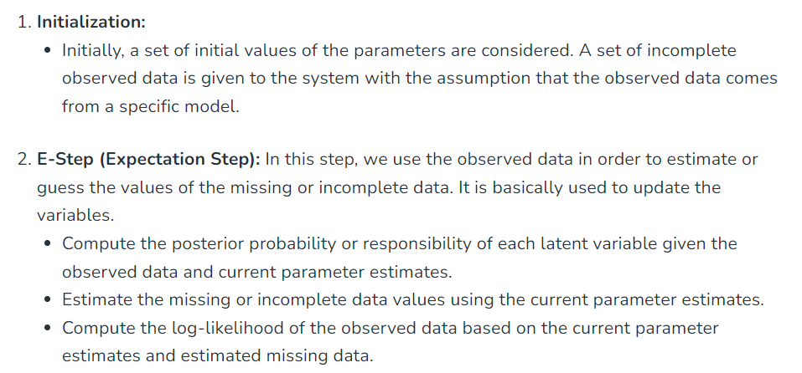

Slide 47
